Slide 1
BUSINESS COMMUNICATION – I
FYBCOM/FYBMS/FYBBI/ FYBAF
Chapter 2 Channels and Objectives of Communication

Slide 2
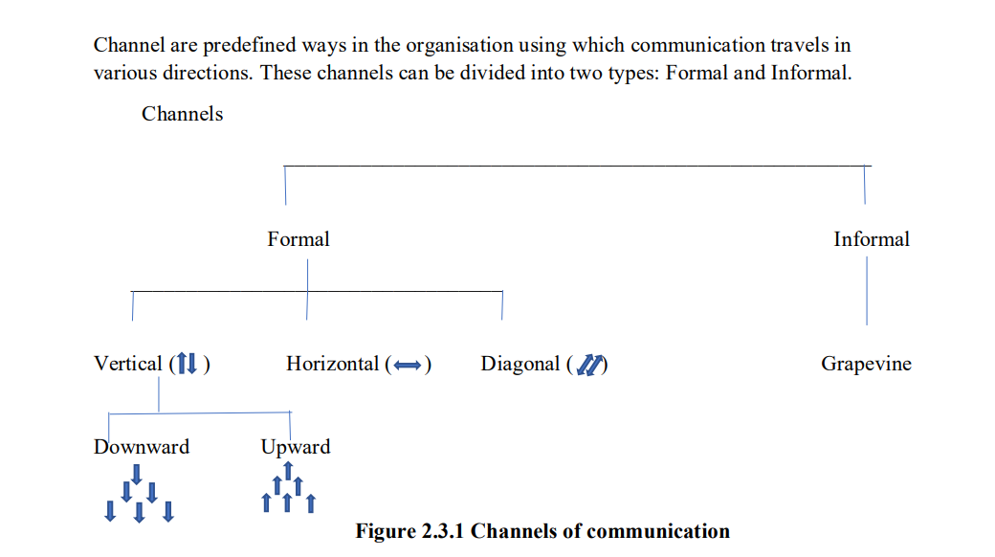

Slide 3
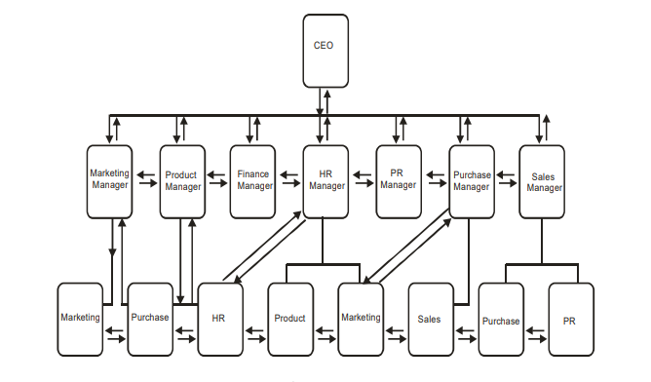
Formal Communication
Refers to the flow of official information through proper, predefined channels and routes.
Messages that move along predefined and regulated pathways comprise formal communication. Formal communication may be verbal or written, and may be in the form of letters, telephone calls, computer messages or memos.
Formal communication follows a hierarchical structure and chain of command

Slide 4
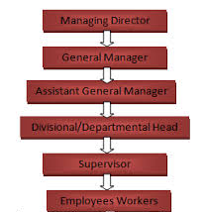
DOWNWARD COMMUNICATION:
In Downward Communication, top management of an organization transmits decisions taken by it, along with its intended goals, vision, culture and ethics through various levels of authority.
All decisions taken by the top management are passed down the ladder of authority for their implementation.
The messages that flow though this channel are orders, memos, rules, practices, procedures, circulars, regulations.
Written orders, bulletins, bulletin-boards, posters, house-journals are commonly used modes of this communication.
As it proceeds from superiors to the subordinates, this communication is also called Top-Down‘ communication.

Slide 5
Downward Communication is needed:
to get the work done
to prepare the workforce for challenges
to tackle misinformation and suspicion arising out of it
to create a feeling of pride and confidence in the workforce in order to motivate it and to boost its morale.
to transmit work ethics and the organisation‘s culture

Slide 6
ADVANTAGES OF DOWNWARD COMMUNICATION
Ensures discipline
Efficient functioning
Tasks and positioning of authority are well defined
It brings team spirit

Slide 7
Disadvantages of Downward Communication
One way communication
Differences in values and perceptions
Mistrust
Inner conflict of leadership
Resistance to authority

Slide 8
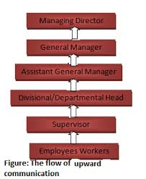
Upwards communication
It is the response to the downward flow of communication.
Encouragement is required to be given to the employees for doing this communication.
Upward communication can be done using written or oral method of communication. Letters, reports, proposals, or queries.
Objectives:
Respond
Discuss progress
Submit ideas
Encourage participation
Improve inter personal relations
It depends upon downward communication

Slide 9
Disadvantages of upward communication
Attitudes of subordinate and superior
Organisational structure
Skipping ranks

Slide 10
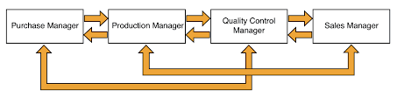
HORIZONTAL COMMUNICATION
Communication with person of relatively equal status in an organization is termed as horizontal communication.
Objective of Horizontal communication
To coordinate functions throughout the organization
To share information
To solve problems
To resolve conflict
Drawbacks of Horizontal communication:
Increased specialization
Lack of recognition and reward
Suppression of differences
Ego clashes

Slide 11
Diagonal Communication
Communication that takes place between people of similar status but different organization.
Eg: When CEO of a Company communicates with CEO of other company.

Slide 12
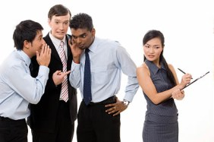
Informal Communication - Grapevine
The informal communication does not follow the lines or authority and is multidirectional in nature.
It is used as a synonym for Rumours or Gossip.
It is not a dependable channel
Grapevine is active when a group of people of similar status and with similar interests are together outside the organizational setup like for eg: in the canteen or in the corridor.
There are various patterns that creates grapevine: Random pattern, wheel pattern, Chain pattern
The grapevine is both useful and harmful to the organization.

Slide 13
Objectives of Communication
Objectives of Communication
Information
Advice
Orders and Instruction
Persuasion
Motivation
Education and training
Warning
Boasting Morale

